Slide 1



Virendra Kumar Patel
Software Engineer
virendra.patel@tavant.com
/virendrapatel62
/feelfreetocode

Slide 2

Image Optimisation With
11th Aug 2022

Slide 3
Agenda:
React
Next JS
Core Web Vitals
Problems with img html element & Solution.

Slide 4

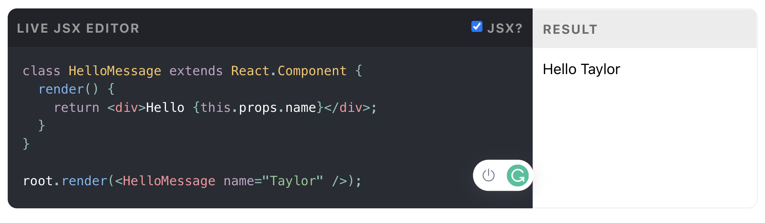
React
A JavaScript library for building user interfaces

Slide 5

The React Framework for Production

Slide 6
Performance
How do we measure performance?

Slide 7
Web Vitals
Largest Contentful Paint (LCP)
First Input Delay (FID)
Cumulative Layout Shift (CLS)
Total Blocking Time (TBT)
First Contentful Paint (FCP)
Speed Index (SI)
Time to Interactive (TTI)
https://web.dev/vitals/

Slide 8
Core Web Vitals
Loading
Interactivity
Visual Stability
https://web.dev/vitals/#core-web-vitals

Slide 9
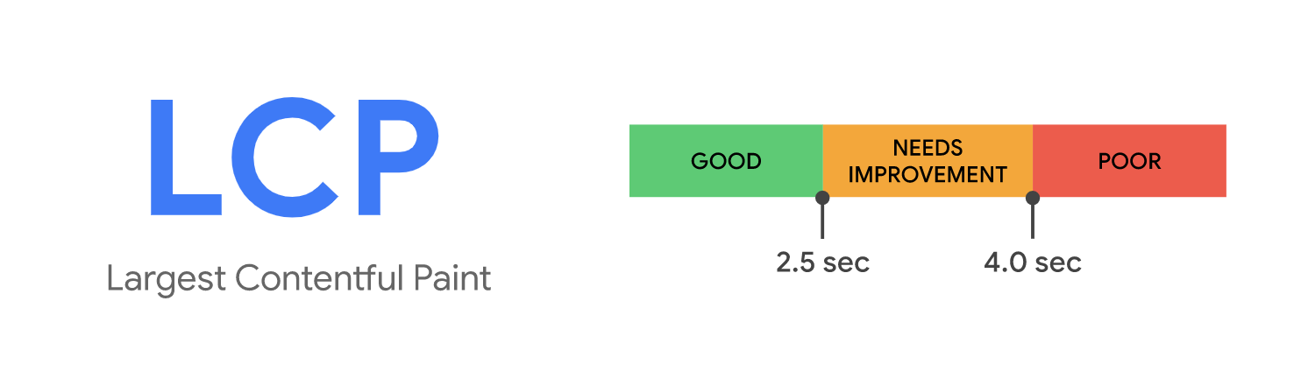

Slide 10
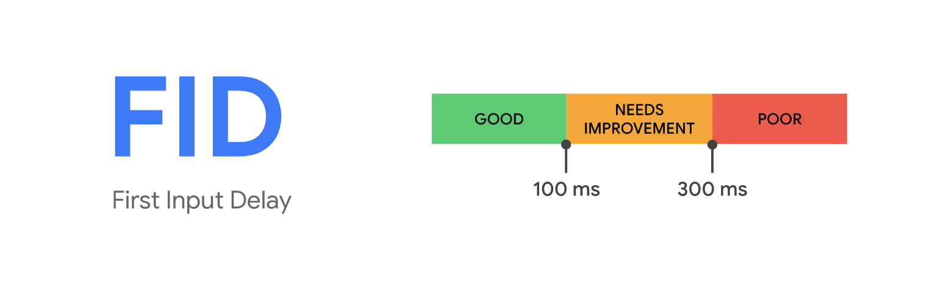

Slide 11
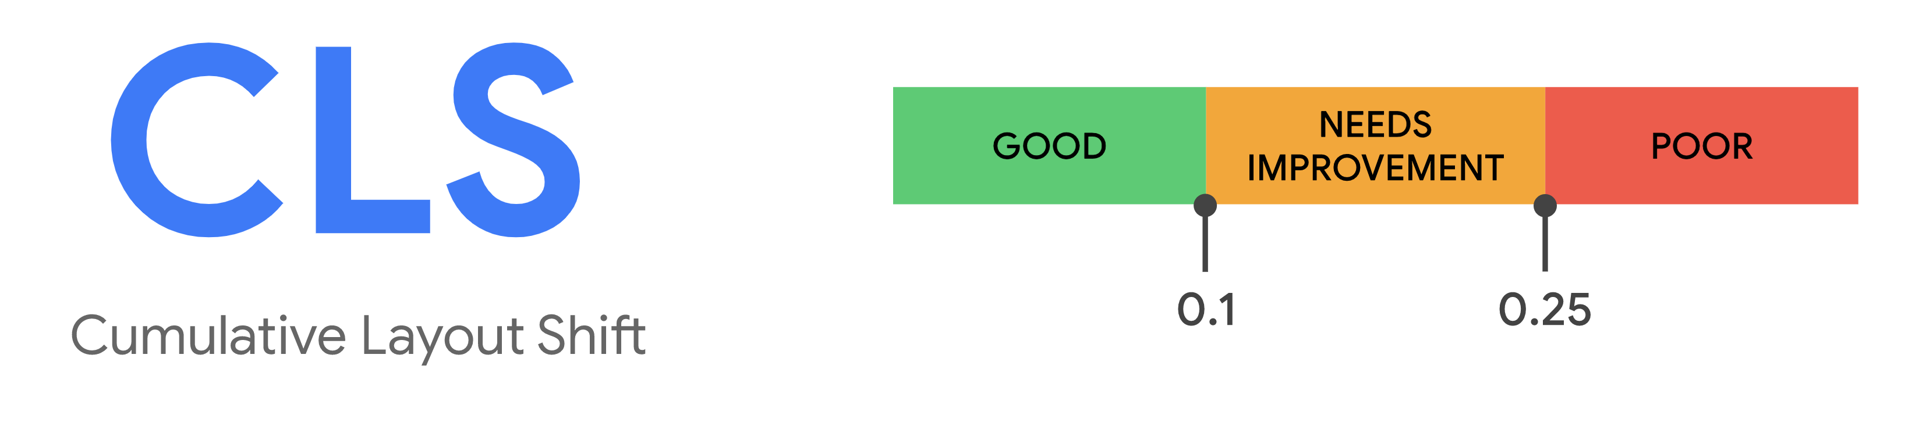

https://web.dev/cls/#layout-shift-score

Slide 12






1. Improper Sized Images
Images shouldn’t larger than necessary

Slide 13
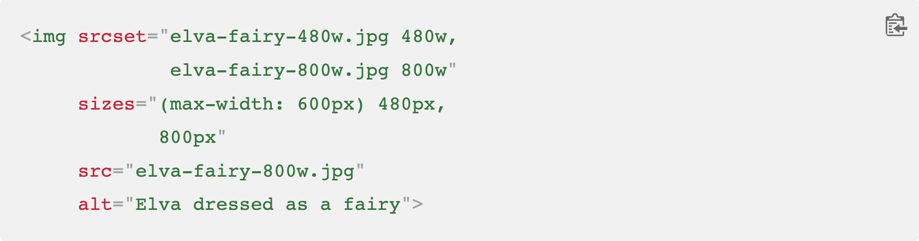
Solution :
Source sets.

Slide 14
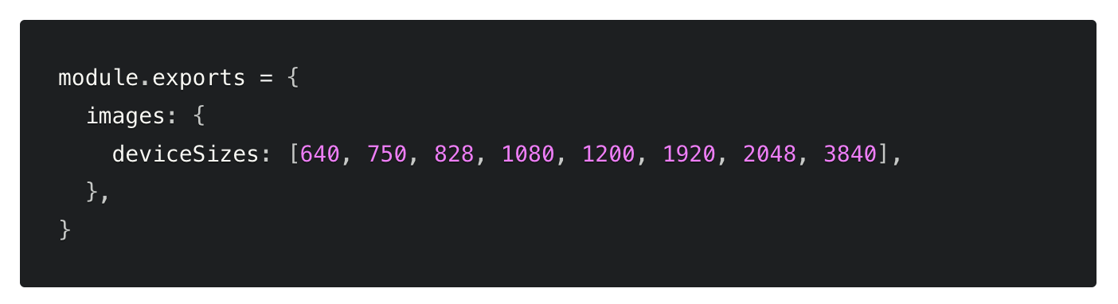
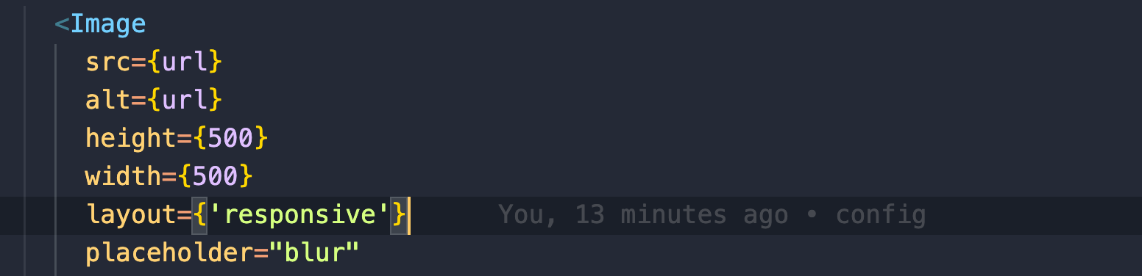
The Image Component
Automatic source set generation.

Slide 15


2. Image format
WebP images are smaller than their JPEG and PNG counterparts—usually on the magnitude of a 25–35% reduction in file size.
But not all browser supports new formats.
Jpg - 292 KB
Webp - 93 KB
https://www.youtube.com/watch?v=rqXMwLbYEE4

Slide 16
Solution :
Use a CDN or setup an image server.

Slide 17
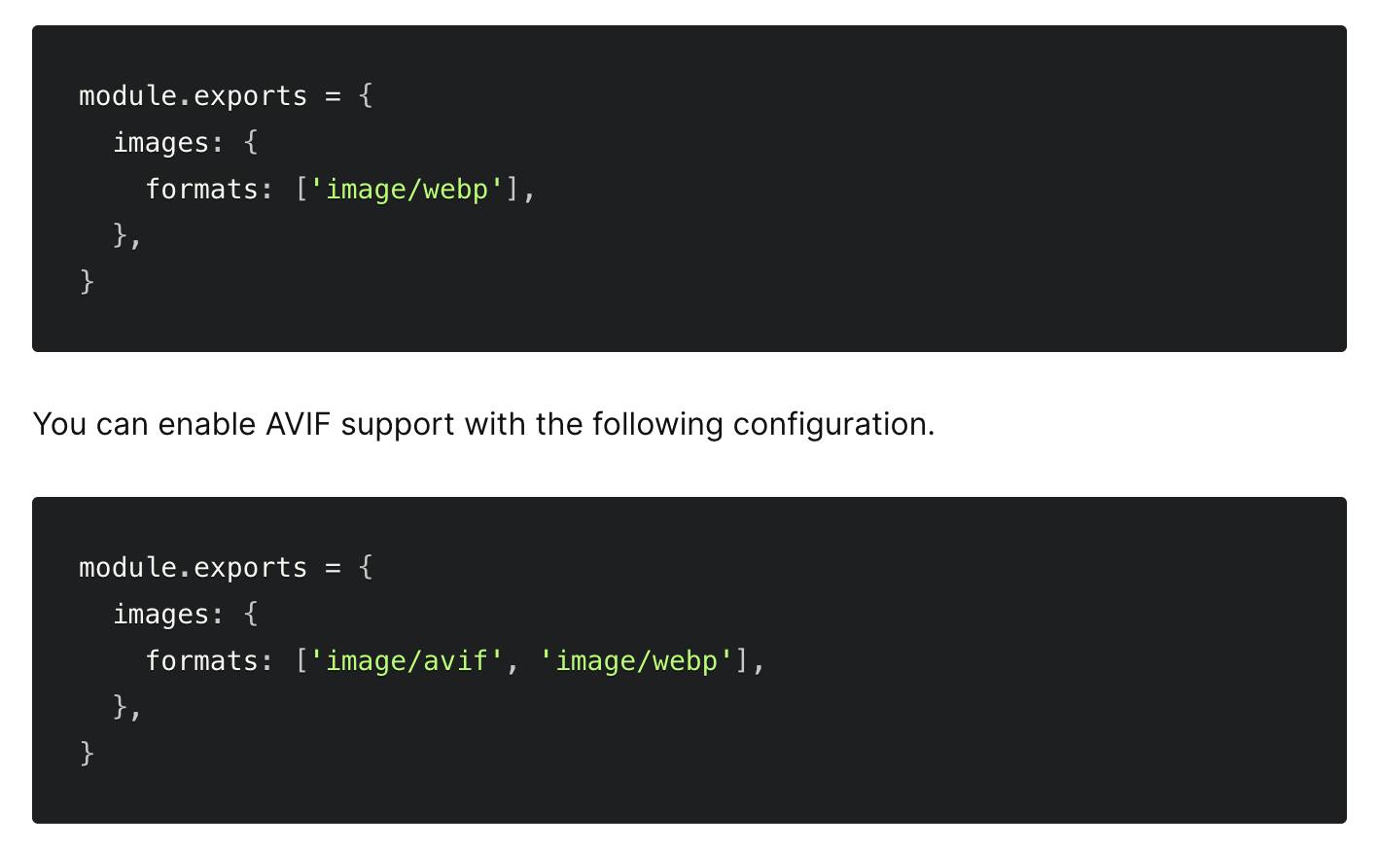
The Image Component
The default Image Optimization API will automatically detect the browser's supported image formats via the request's header.
https://nextjs.org/docs/api-reference/next/image#built-in-loaders

Slide 18

3. Lazy Loading & Blur thumbnail

Slide 19
Solution :
Tricky to implement : event listeners, scroll events, loading attribute.
Not all browsers support loading attribute.
Notes:
Below Safari 14.1 on macOS Big Sur.

Slide 20
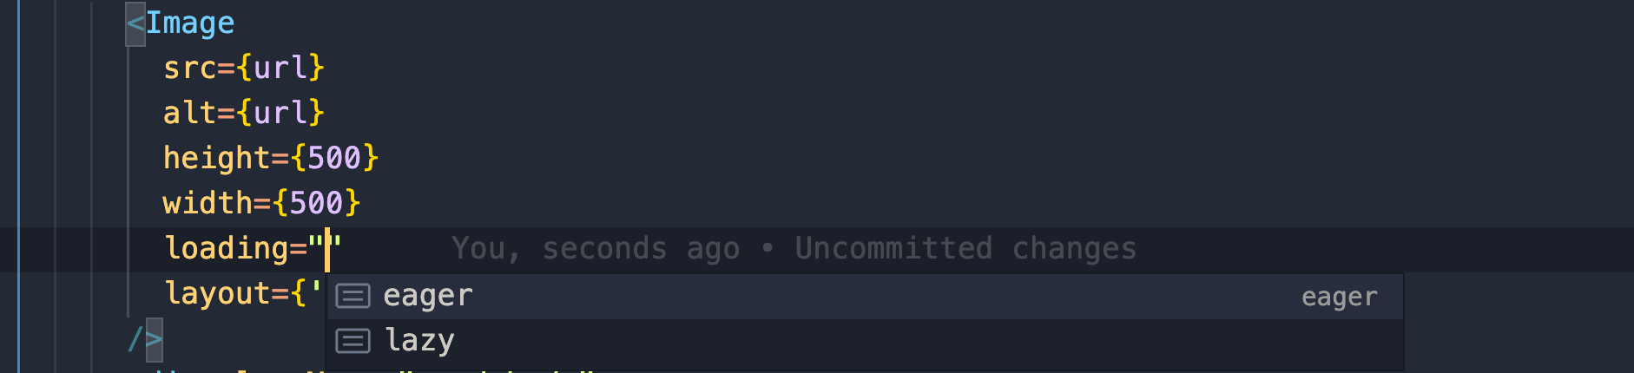
The Image Component
Turn off lazy loading with priority or loading=“eager”

Slide 21

4. Image Preloads
Preload lets you tell the browser about critical resources that you want to load as soon as possible

Slide 22
Solution :
<link rel="preload" href=“iphone20.jpg” as=“image">
https://developer.mozilla.org/en-US/docs/Web/HTML/Link_types/preload

Slide 23
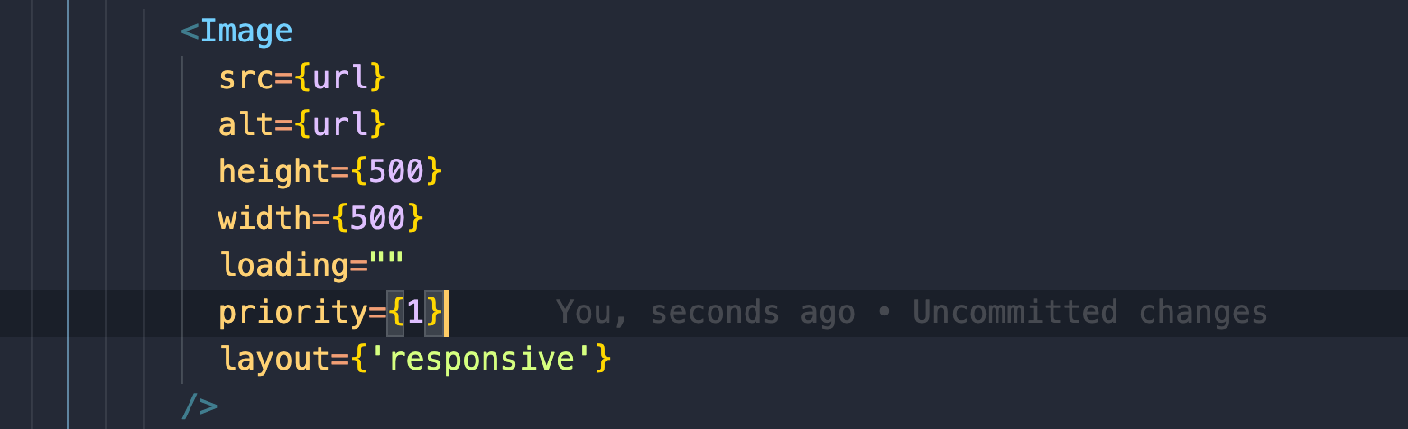
The Image Component
The Image Component make this process much easier.

Slide 24
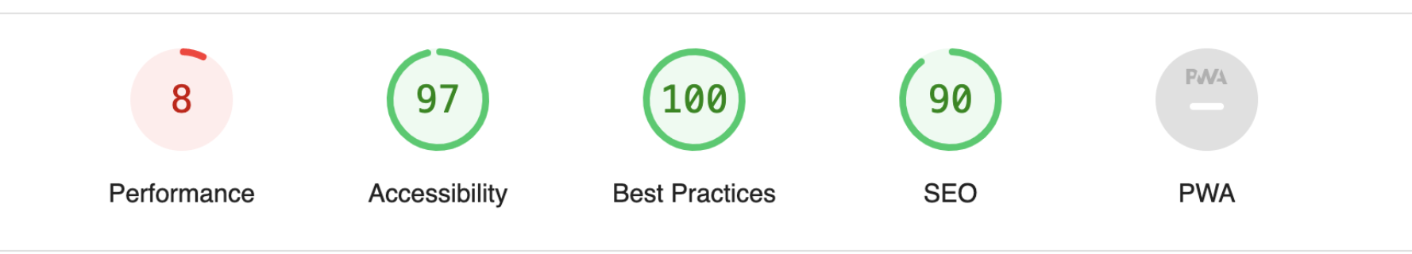
Performance with img tag

Slide 25
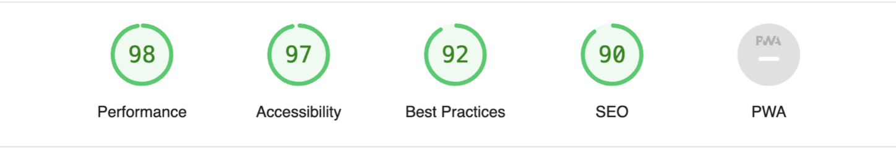
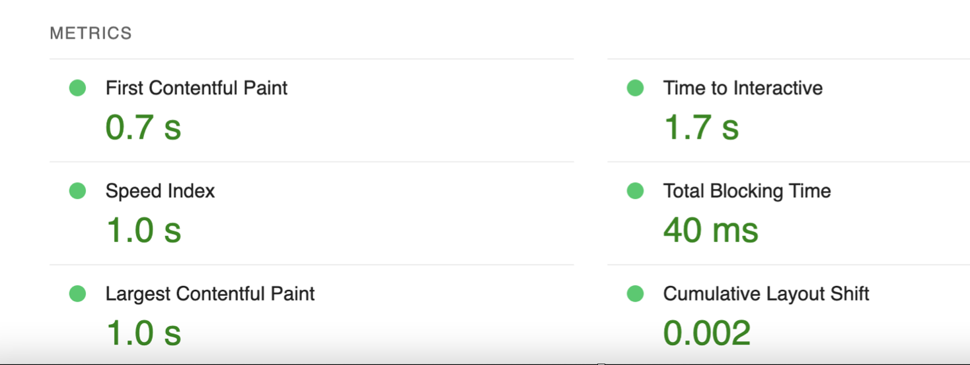
Performance with Image Component

Slide 26
Thank you :)
TODO with vanila JS
TODO with React
https://github.com/virendrapatel62/next-brown-bag
https://next-brown-bag.vercel.app/
Javascript : https://www.youtube.com/watch?v=2qDywOS7VAc&t=26s
https://www.javascript.com/
https://github.com/virendrapatel62/Javascript-fullstack-crash-course

